Slide 1
Happy Tuesday

Slide 2
Reminders & Lessons Learned from 2021
Deborah Kukulich – DelDOT Utilities Section
Stephen Wright – DelDOT Canal District Public Works

Slide 3
Deldot’s utility design process
DelDOT has a four-step process in a capital project.
Concept and/or Survey Plan Phase
Introduction to the project
Preliminary
1st look at the new alignment/design.
Note: The Bridge Section has added a new in-between phase called “Conceptual” plans.
Semi-Finals
Most of the drainage is designed.
Final ROW Plans are being finalized.
Finals
Last review before project goes out to bid and construction
Each step requires information from the utility companies.

Slide 4
Concept / survey phase
Beginning of the project planning phase
The Concept/Survey plans are the existing condition plans showing the minimal information.
The utility company’s uses these plans to showing their existing facilities.
DELDOT identifies whether or not designation through a SUE firm will be needed.
When SUE is performed, DelDOT tries to have this done prior to the Survey submission.
The utilities are required to review and confirm their facility locations on the plans regardless of the Department's use of a SUE consultant.
(DelDOT Utility Manual 5.1.1.2)
What does the utility have in the project limits? NOW is the time to think about system upgrades
Can it be easily relocated? NOW is the time to bring up hardships. Helps to set scope of project.
Utility Easements – Provide documentation to DelDOT
Are test holes (TH’s) need to identify the utility?
Any existing private services (meter pits, service drops, etc.) that may be affected.

Slide 5
Preliminary phase
The preliminary Utility relocation design is needed.
Things to consider when reviewing:
Is additional ROW needed to relocate? How much is NEEDED?
Do the project limits need to be extended for the utility to connect back into their existing facilities?
Test Holes (TH’s) are performed to physically identify the utility.
Information on any other utility's facilities located on a pole owners poles.
(DelDOT Utility Manual 5.1.3.3.5)
A utility may be dependent upon another utility's plans and actions in order to complete the work. The Utility Coordinator should be made aware of this condition in order to ensure efficient coordination of the project.

Slide 6
Semi-final phase
The Utility shall provide detailed relocation design based on semi-final plans.
Are there any long lead time items that need to be ordered? The Utility should ask DelDOT for an NTP for Ordering Materials.
The Utility shall provide their Utility Statement to DelDOT.
A description of the existing facilities;
Any proposed changes, adjustments, or relocations;
The location of the changes using station count and offsets;
Quantities of borrow Type C if necessary; SUBJECT TO DELDOT APROVAL
The proposed time schedule (in calendar days) for completing the alterations, adjustments, or relocations for each phase of the Project's Sequence of Construction/ Maintenance of Traffic Plan:
Any other information that may impact the State's contractor.
(DelDOT Utility Manual 5.1.4)
Semi-Final Plans are essentially DelDOT’s FINAL ROW Plans.
Is any of the Utility work reimbursable? DelDOT will need estimates from the utility companies on letterhead.

Slide 7
Final phase
The final utility relocation schedule (bar chart) is established by DelDOT based on utility statements provided by companies.
The Utility shall review for any design conflicts with DelDOT facilities or other Utilities.
Internal work orders need to be prepared. Order materials based upon the project schedule.

Slide 8
Each phase has an important role
Accurate information and responses needed from everyone at ALL design phases.

Slide 9
Question

Slide 10
Notes:
Poll Title: Do not modify the notes in this section to avoid tampering with the Poll Everywhere activity. More info at polleverywhere.com/support Why does DelDOT have so many design phases? https://www.polleverywhere.com/multiple_choice_polls/ULN5dtW4fiE9ORJ5NKB75?state=opened&flow=Default&onscreen=persist

Slide 11
Information Needed Early
Need insight into project relocations as early as possible in the design process to make informed decisions.
Designs need to take existing facilities/operations and proposed phasing/improvements of highway project AND ALL existing/proposed utility relocations into account.
Horizontal placement of utilities within ROW should be determined based on efficient constructability.
Any proposed new utilities/upgrades through the project limits need to plan for project relocations (e.g. additional aerial cable to set on new pole line, etc.).

Slide 12
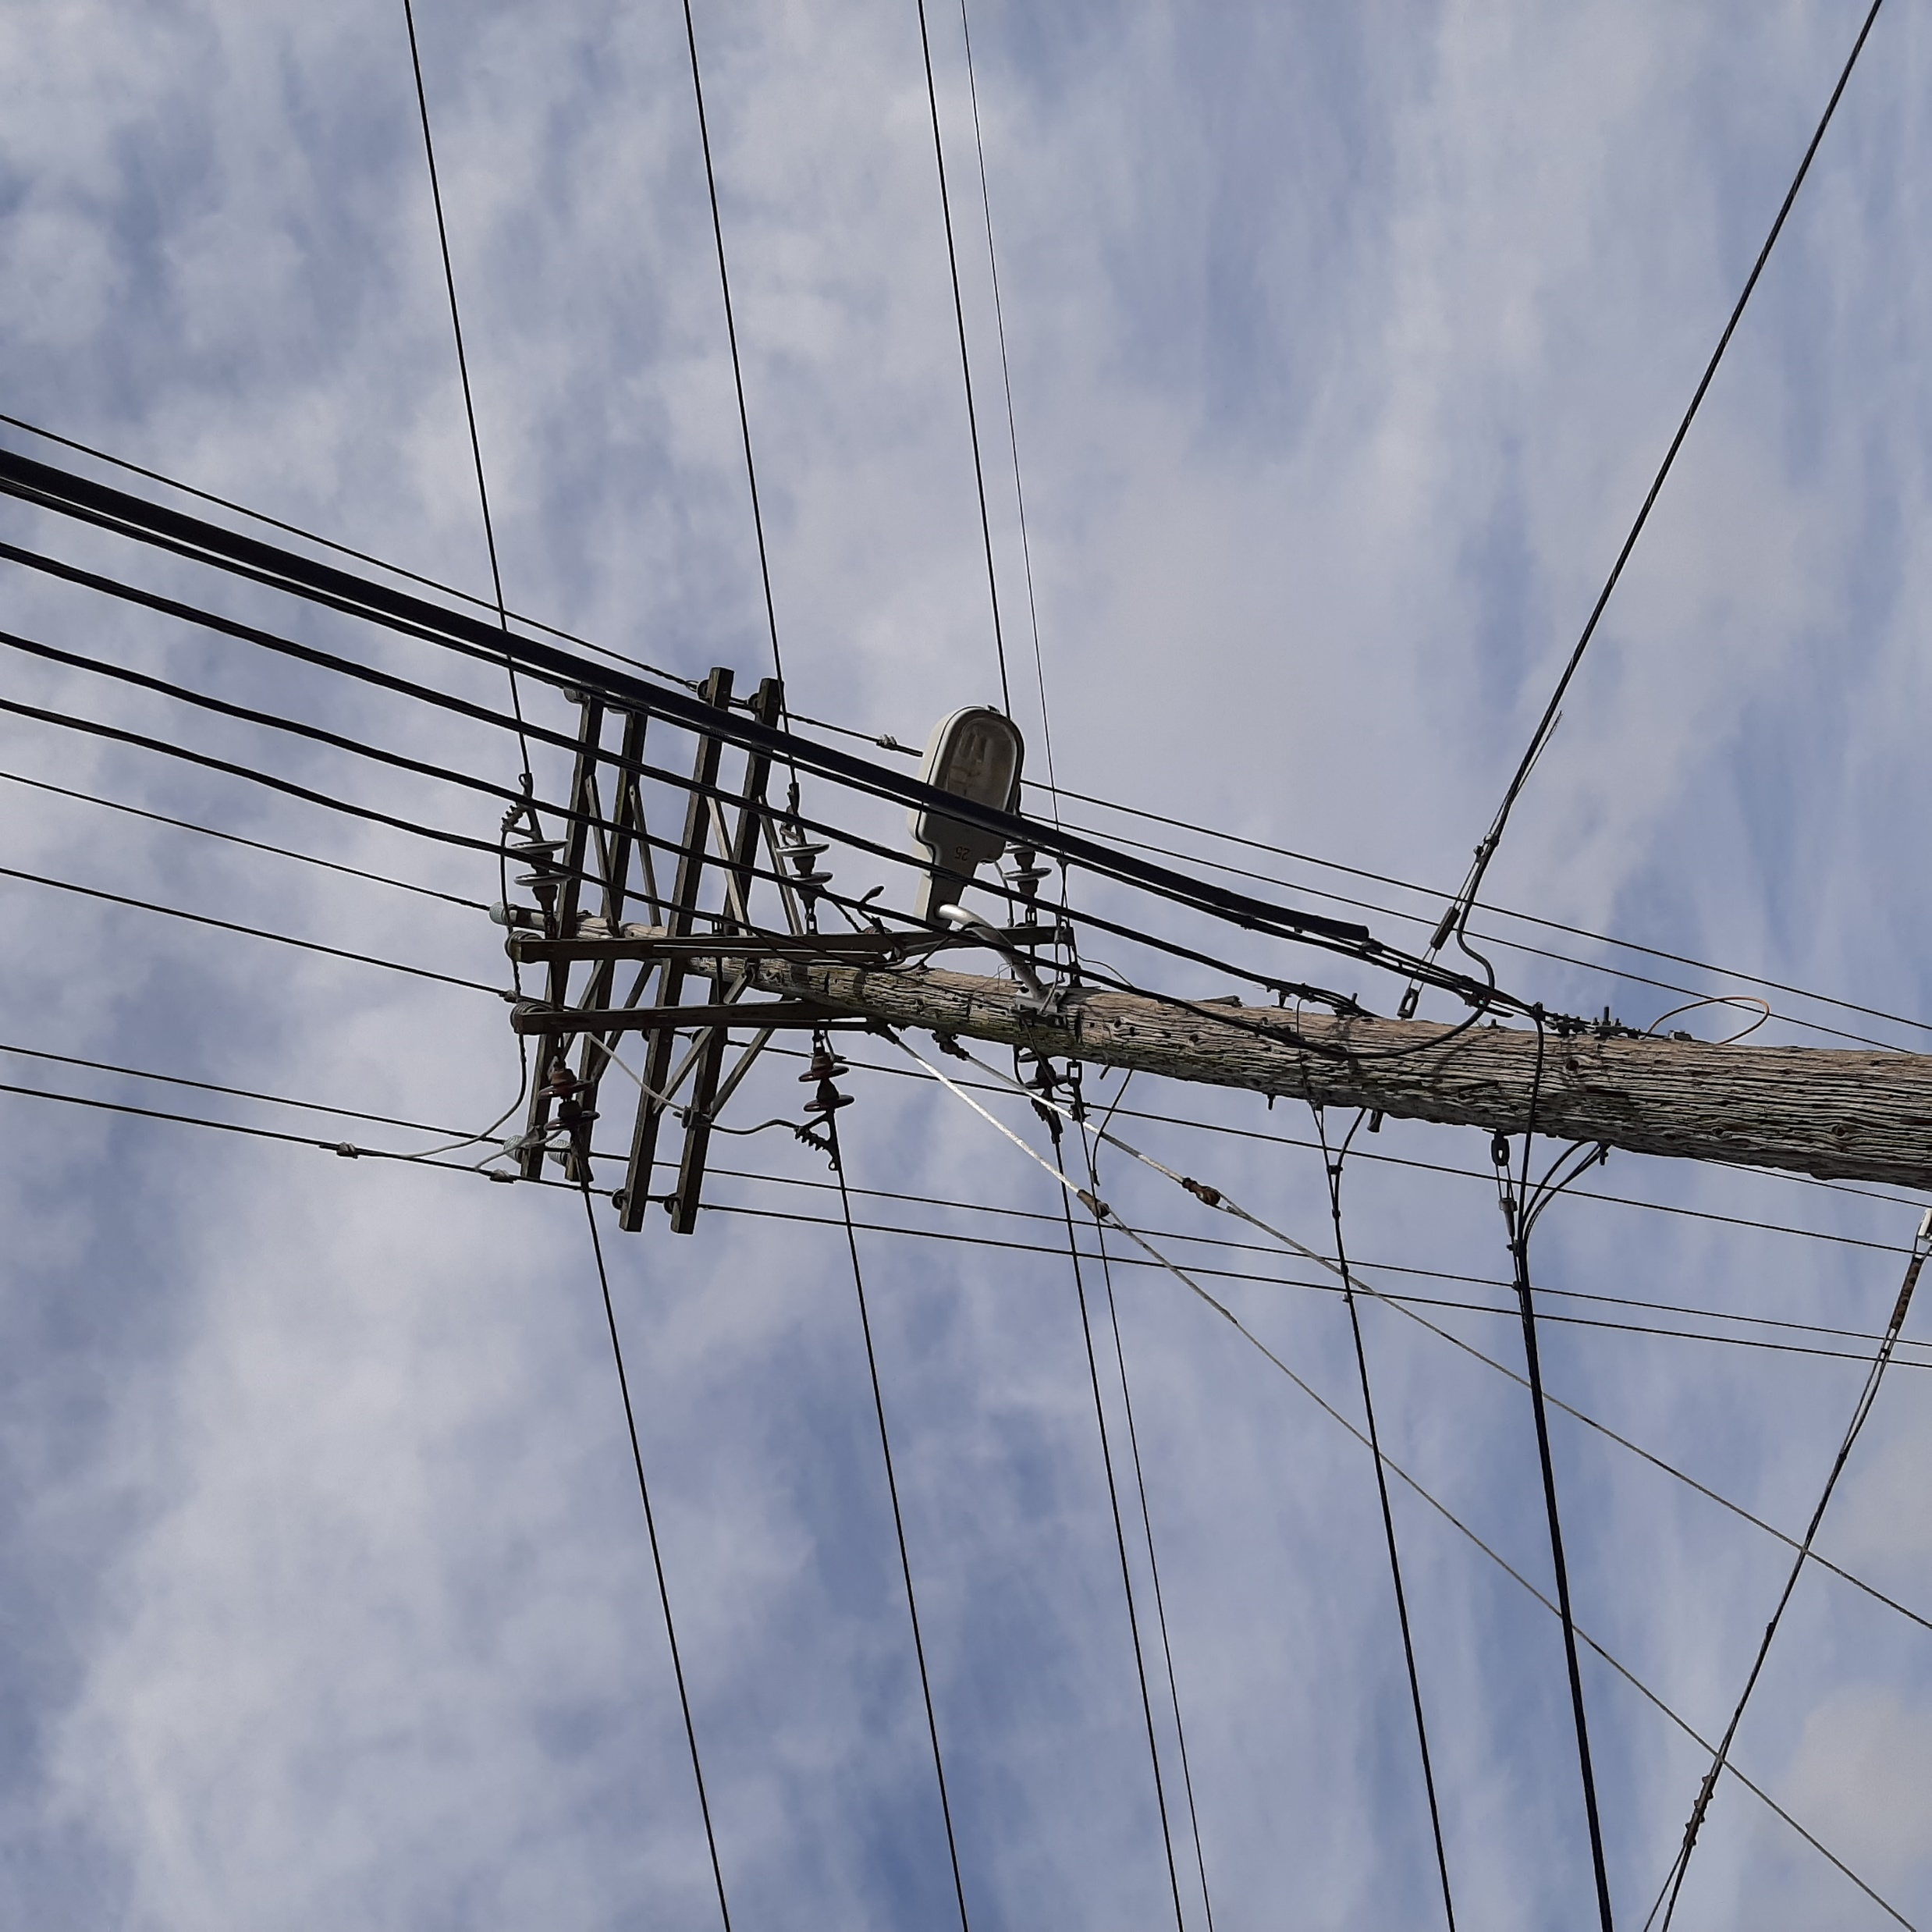
other important items to consider
Utility points of service need to be incorporated into all designs.
Confirm the new electric services do not conflict with old services until they are removed.

Slide 13
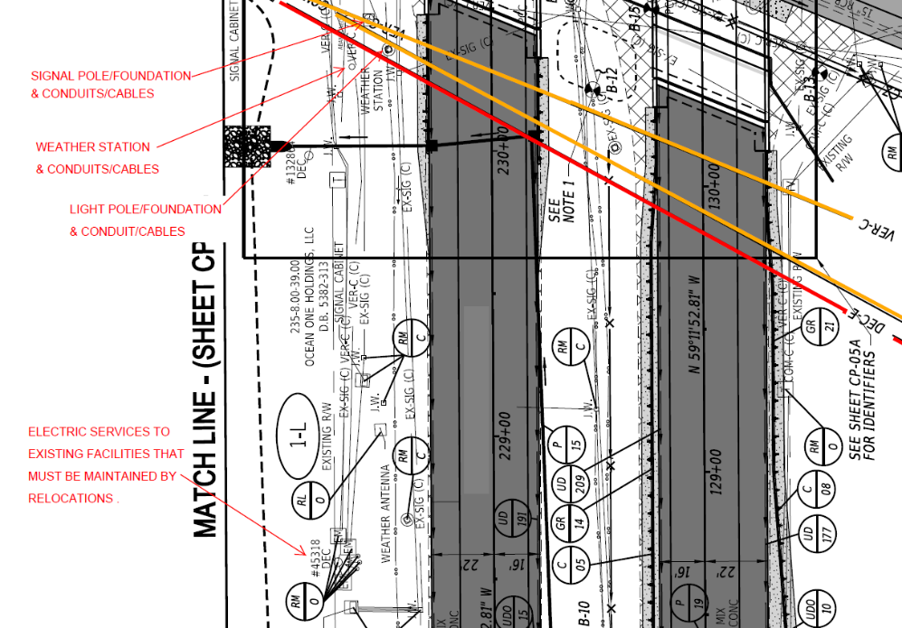
Conflicts with existing aerials
Original relocations from utility companies:
Alignment-shortest distance
Conflicts with existing:
Signal pole/foundation
Roadway light pole/foundation\
Weather station
& Conduit/cables to these facilities
Need to maintain electric service to existing facilities, until road construction no longer requires.
And provide for new electric services to new facilities built by road construction & customers.

Slide 14
Question

Slide 15
Notes:
Poll Title: Do not modify the notes in this section to avoid tampering with the Poll Everywhere activity. More info at polleverywhere.com/support There are _____ times more chickens than people in Delaware? https://www.polleverywhere.com/multiple_choice_polls/Ig4t2HnGNiPKch5doZNIW?state=opened&flow=Default&onscreen=persist

Slide 16
Design Changes

Slide 17
DelDOT Design Changes
Design changes late in the design/coordination process are detrimental!
Examples:
Adding/altering drainage at final plans
Changing alignments
Adding work
Changes cannot be made without considering how it impacts others associated with the project and without adjusting anticipated schedules.

Slide 18
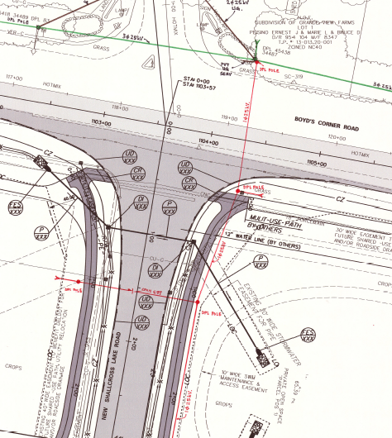
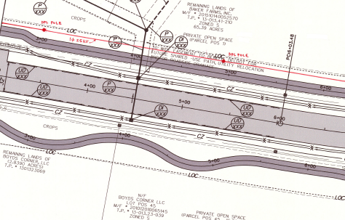
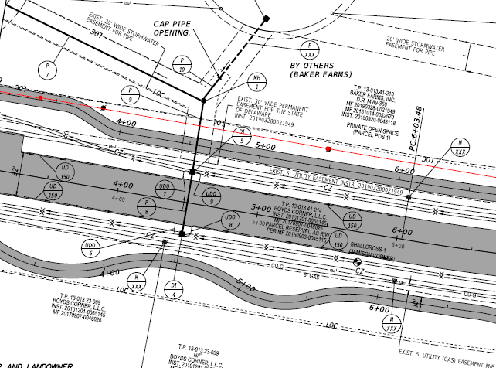
before
The pole owner submitted a relocation design shown in red with the sidewalk design shown here.
After
The design team redesign the sidewalk and moved the pole line. After a coordination meeting, the pole owner shifted the pole line to accommodate the revised sidewalk.

Slide 19
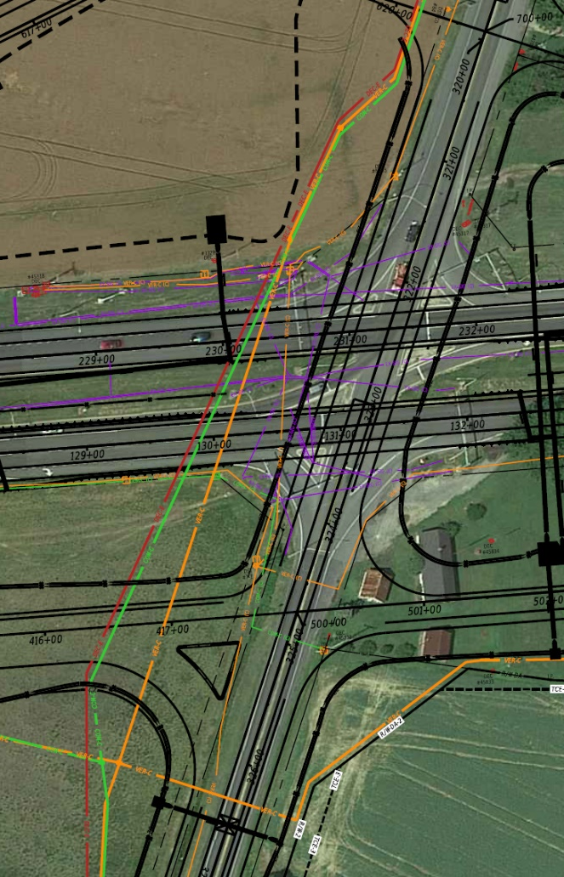
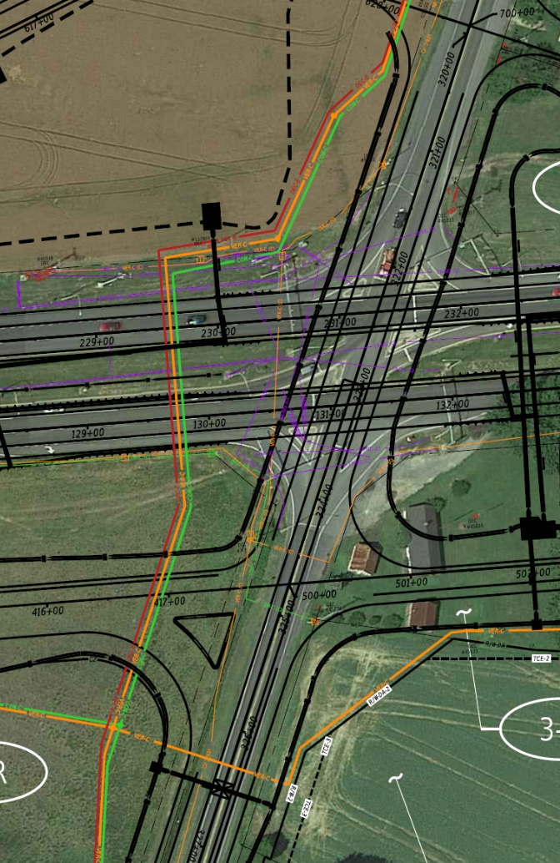
Original Utility Relocation Alignments
Coordinated Utility Relocation Alignments

Slide 20
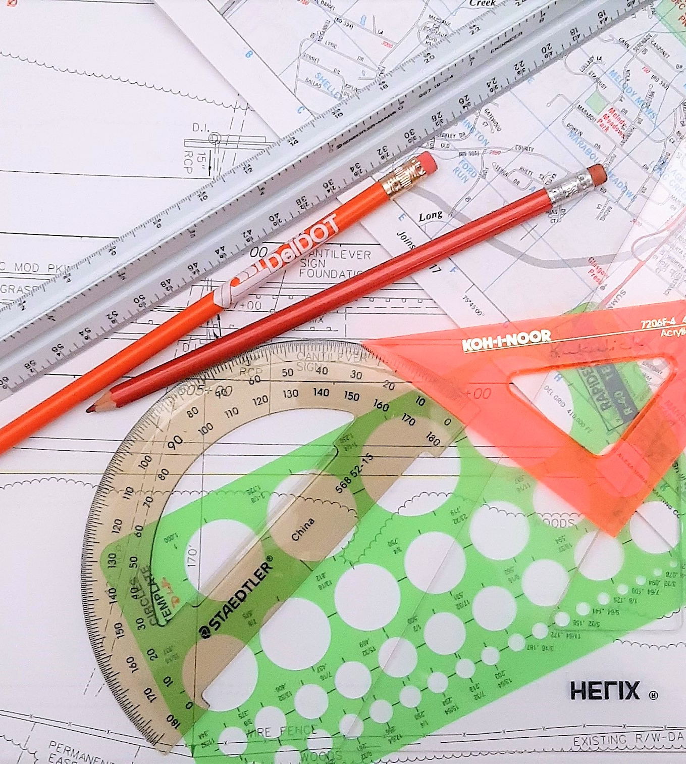
Utility Design Changes
Design changes late in the design/coordination process are detrimental!
Examples:
Changing from aerial relocation to underground
Moving poles
Shifting alignment
Changes cannot be made without considering how it impacts others associated with the project and without adjusting anticipated schedules.

Slide 21
Constructability – Design Side
Constructability of all elements should be considered throughout the design/coordination project. Constructability reviews should be held by all.
Things to consider as the plans are being reviewed:
Poles too close to proposed drainage but not realized until construction leading to pole holds
Large equipment will be needed to perform work requiring outage from utility & outage limitations
Excavations, clearing, embankments/settlements & other work required by contractor prior to relocations starting
Maintaining service to highway operations (signals, lighting, ITMS) & other customers throughout utility relocations and highway construction

Slide 22
Advanced work & what is needed
It can take a year or more to perform all utility work in advance of highway construction.
Remember utilities cannot usually work at the same time. There is a hierarchy to most work.
Needs to be decided as early in the design/coordination process as possible.
Things needed in order to perform advanced work:
Authorization to work on property (ROW settled, Right of Entry, etc.)
Vegetation Removal
Demolition/Relocation (crops, fences, buildings, billboards, lighting, signal spans, septics, etc.)
Cuts/Fills
Stakeout
DelDOT may need to establish a contract or letter bid work prior to.
Does the project schedule account for this??

Slide 23
Question

Slide 24
Notes:
Poll Title: Do not modify the notes in this section to avoid tampering with the Poll Everywhere activity. More info at polleverywhere.com/support What is/are the most useful components of advanced utility inspection? https://www.polleverywhere.com/multiple_choice_polls/1NzjhWUKFUkOR0VmwiDcJ?state=opened&flow=Default&onscreen=persist

Slide 25
Utility Inspection Team a Must!
Specifically needed when there is advanced work on a project.
On-site team
Is the on-site contact for everyone
Proactively coordinates with all companies related to work and schedules
Has ability to coordinate any needs and answer questions
Resolves issues to keep work progressing
Ensures work progressing in accordance with plans or as authorized in approved change
Obtains as-built data and provides back to design team
This has been very beneficial for all projects where it was utilized.
Provides one person as point of contact.

Slide 26
Benefits for the utility companies
Increases response time between the utility company, designer, and DelDOT’s construction.
On-site troubleshooting to increase productivity.
Assists the utility contractors with stakeouts, alignments, and conflicts.
Reduces the utility damages during construction including re-staking.
Increases response time if utility damaged occurs.
Increases accuracy of the alignment during installation.
Contractors have on-site assistance.
On-site adjustments can be accurately measured and set to design for approval.
Utilities are asbuilted during installations.
Logs site conditions that may prevent construction.
Passes on utility conflicts during construction to DelDOT which leads to a quicker resolution.
Stays in constant contact with utility locators for complete and correct utility markings.
Make certain contractors are following all safety guidelines.

Slide 27
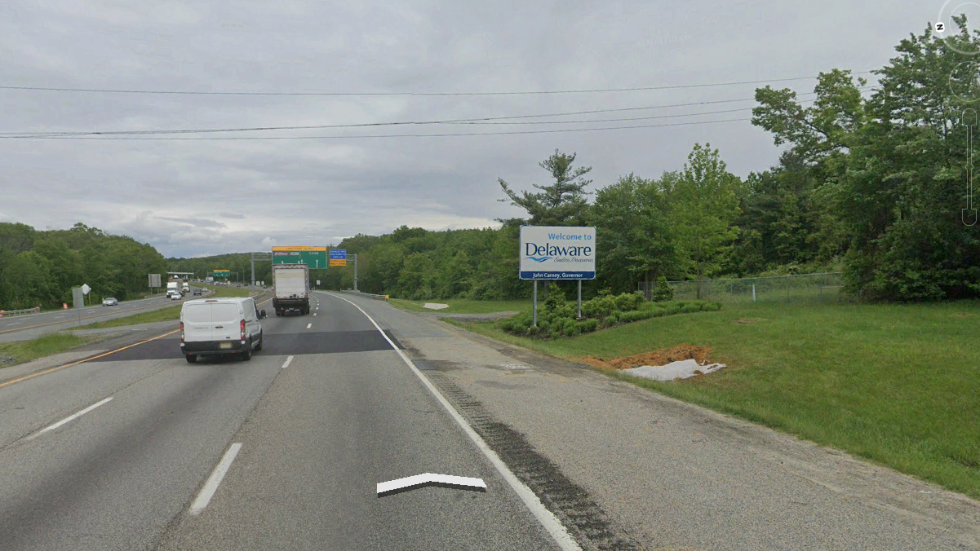
Question

Slide 28
Notes:
Poll Title: Do not modify the notes in this section to avoid tampering with the Poll Everywhere activity. More info at polleverywhere.com/support President John F. Kennedy helped open the Delaware Turnpike on November 14, 1963. https://www.polleverywhere.com/multiple_choice_polls/QaljZQBF6jOz05NLUsMor?state=opened&flow=Default&onscreen=persist

Slide 29
Construction
The project has been awarded.
Contractor is on board
All submittals have been received.
Proposed design, phasing, and durations have been submitted.

Slide 30
Things to consider before accepting the contractor’s changes.
Means and methods of proposed work differ from what was coordinated during design.
Cast-in-Place structures going to Precast
Sandbag stream diversion going to Sheeting
Project phasing change from what was anticipated during design/coordination. Changes need to be coordinated with utility companies.
Changes may not be possible without severe impacts to the highway design or that of utility companies.
Design may not be able to accommodate proposed change. Need to obtain approval prior to allowing change.
Utility may not be able to support changes. Need to obtain agreement prior to approving change.
May result in increased costs and schedule delays.
Utility relocation designs and statement MUST be held firm when compared to highway contractor’s means and methods.

Slide 31
Utility changes after all submissions
Utility relocation designs and statement MUST be held firm.
Alterations to design, phasing, timing and durations of work.
Proposed relocation design is altered when utility contractor brought in to perform work.
Relocation being changed from aerial to underground.
Poles being moved significantly
Changes may not be possible without severe impacts to the highway design or that of other utility companies.
Design may not be able to accommodate proposed change. Need to obtain approval prior to allowing change.
Utility may not be able to support changes. Need to obtain agreement prior to approving change.
May result in increased costs and schedule delays.

Slide 32
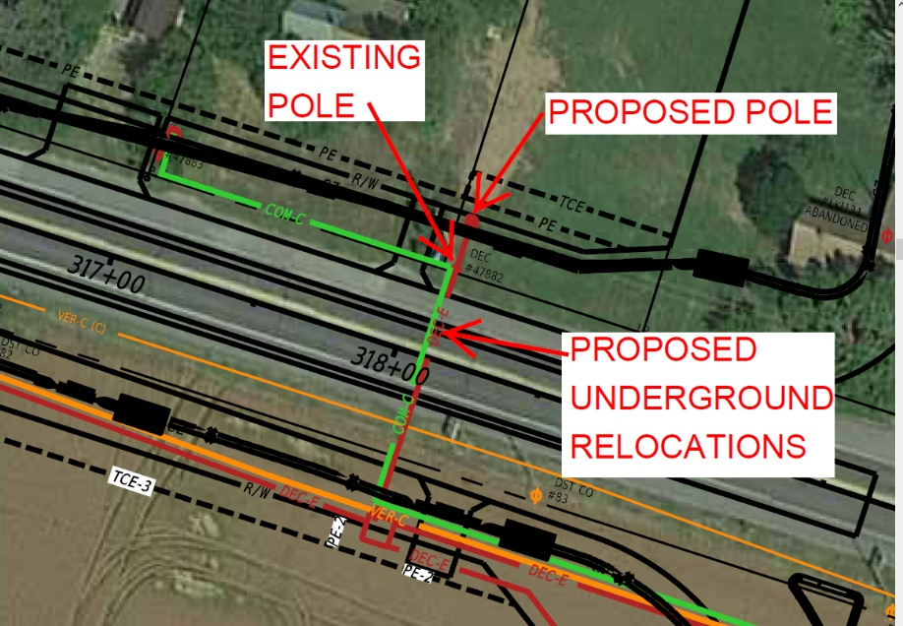
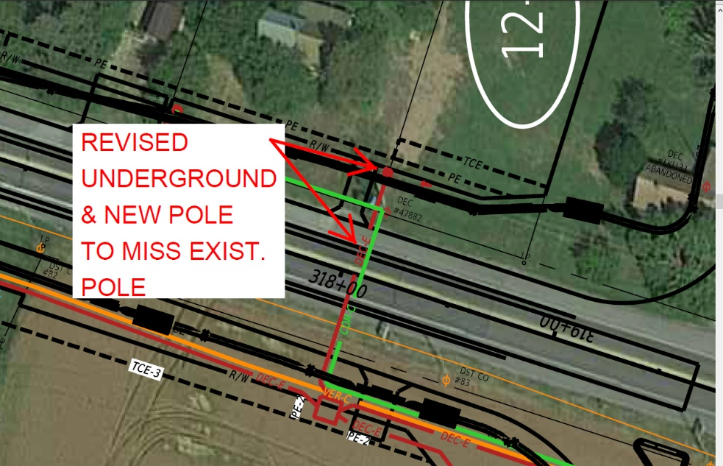
ORIGINAL DESIGN
COORDINATED DESIGN
Relocation designs must consider existing facilities.
Existing facilities remain in service until relocations are complete and put in service.
Minimize adjustments in the field, no matter how ‘small’.
All field adjustments must be reviewed by engineer of record and possibly other utilities.
Project conflicts.
Right-of-way availability.
Environmental impacts.
Public commitments.

Slide 33
Design vs constructed
Before
After

Slide 34
Pavement and rehabilitation projects

Slide 35
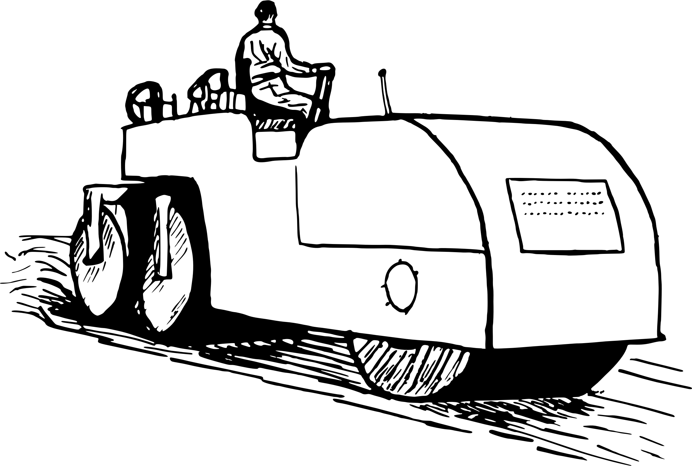
Pave and rehabs
A good portion of the budget is spent on pave and rehabs.
Pave and Rehabs are projects that are quick turn-arounds.
Locations are just a dark stripe over the road.
Minimal information is provided.
Several locations are bundled together.
Minimal utility participation is anticipated.
No defined schedule, usually construction spans over a couple of years.

Slide 36
MAINTENANCE PROJECTS
The other DelDOT

Slide 37
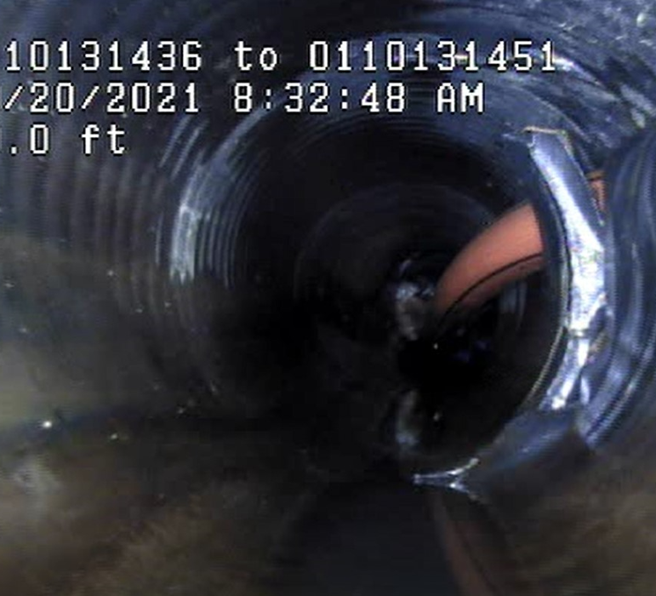
MAINTENANCE projects
Maintenance and Operations (M&O) oversees the repairs, maintains, and upgrades to the State’s infrastructures.
These projects can come up fast and have short deadlines.
Do the best we can to give everyone as much time as possible to coordinate and perform work
Designers need to understand it takes time to:
Properly coordinate impacts
Set up agreements and funding
Complete relocation work
Utilities need to understand:
Accurate and quick responses are needed to keep projects moving
Delaying responses and work causes issues for everyone

Slide 38
QUESTION

Slide 39
Notes:
Poll Title: Do not modify the notes in this section to avoid tampering with the Poll Everywhere activity. More info at polleverywhere.com/support Which public utility system came first in the USA? https://www.polleverywhere.com/multiple_choice_polls/TvkgV3iw7dgtdIpaUV5Ns?state=opened&flow=Default&onscreen=persist

Slide 40
Thank you!

Slide 41
What is Public Works?
DelDOT Public Works are responsible for all permitting of access to State right-of-way.
DelDOT Public Works processes approximately 3,000 utility permits per year, just over 1,300 permits a year comes from the Canal District in New Castle County.
Our primary tool for processing all those permits is the Utility Permit Application (UPA), a web-based service which can be found at services.deldot.gov.

Slide 42
What is the utility permit application (UPA)?

Slide 43
What does public Works do with all those permits?
DelDOT Public Works is charged with inspecting all construction within the State Right-of-Way from any private construction.
We document them so that big brother can always be watching!!!
There is a lot going on within the State ROW;
There is a DelDOT truck or contractor doing work in the ROW every single day
There are is private construction taking place in the ROW every single day
There is utility maintenance and new construction taking place in the ROW every single day.
The permits are how we document who is doing what work within the ROW to minimize impacts to the travelling public and conflicts between multiple construction projects taking place at the same time
Finally the permits are how we track what is physically in the ROW to inform future road construction projects and maintenance of the existing facilities

Slide 44
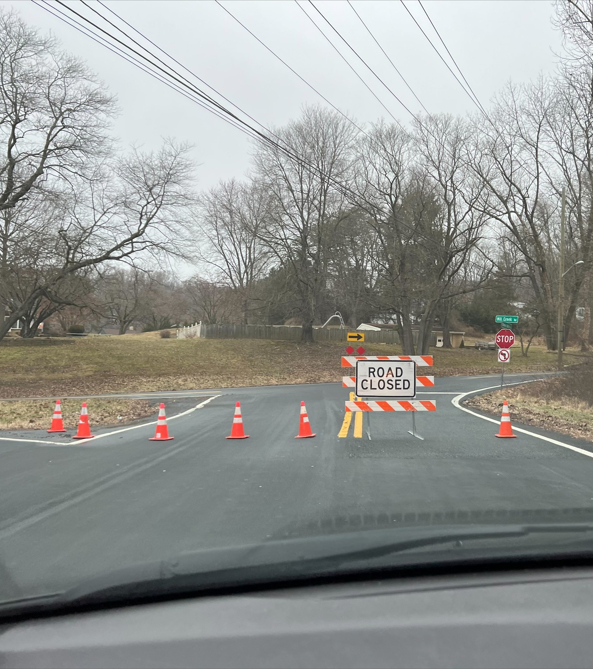
Why is Public Works calling me?
Because someone called Public Works?
Because you don’t have a permit?
Because something went wrong?
Yes!

Slide 45
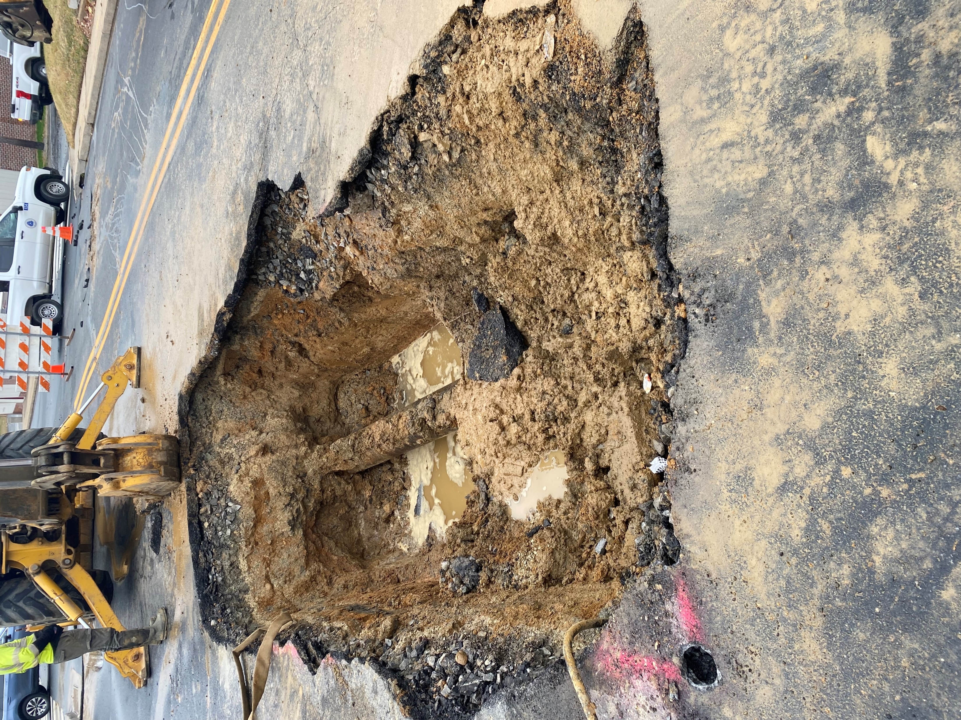
Who calls Public Works?
State Representatives
Jane / Joe Public
Other Utilities
Other sections within DelDOT
Surveyors and Engineering Firms
Pretty much everybody…
…Hopefully YOU!

Slide 46
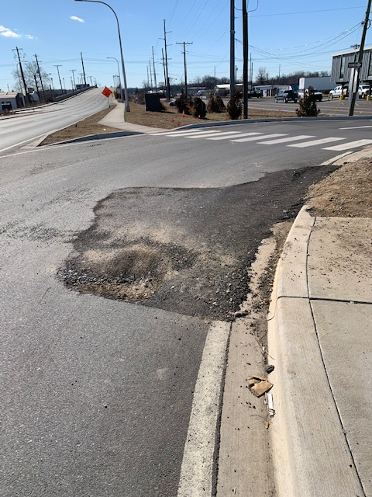
What do you do after they call?
We identify the location from the contact
Then a Public Works inspector lays eyes on the issue to field verify and predict the cause
If the root cause of the complaint is not obvious, they photo document the issue and geolocate the failure
Back in the office the inspector and their manager will target the issue in GIS and superimpose the known permits and utility locations
Then we call the most likely responsible party
Sometimes…we don’t know and in that situation we will reach out to multiple franchises

Slide 47
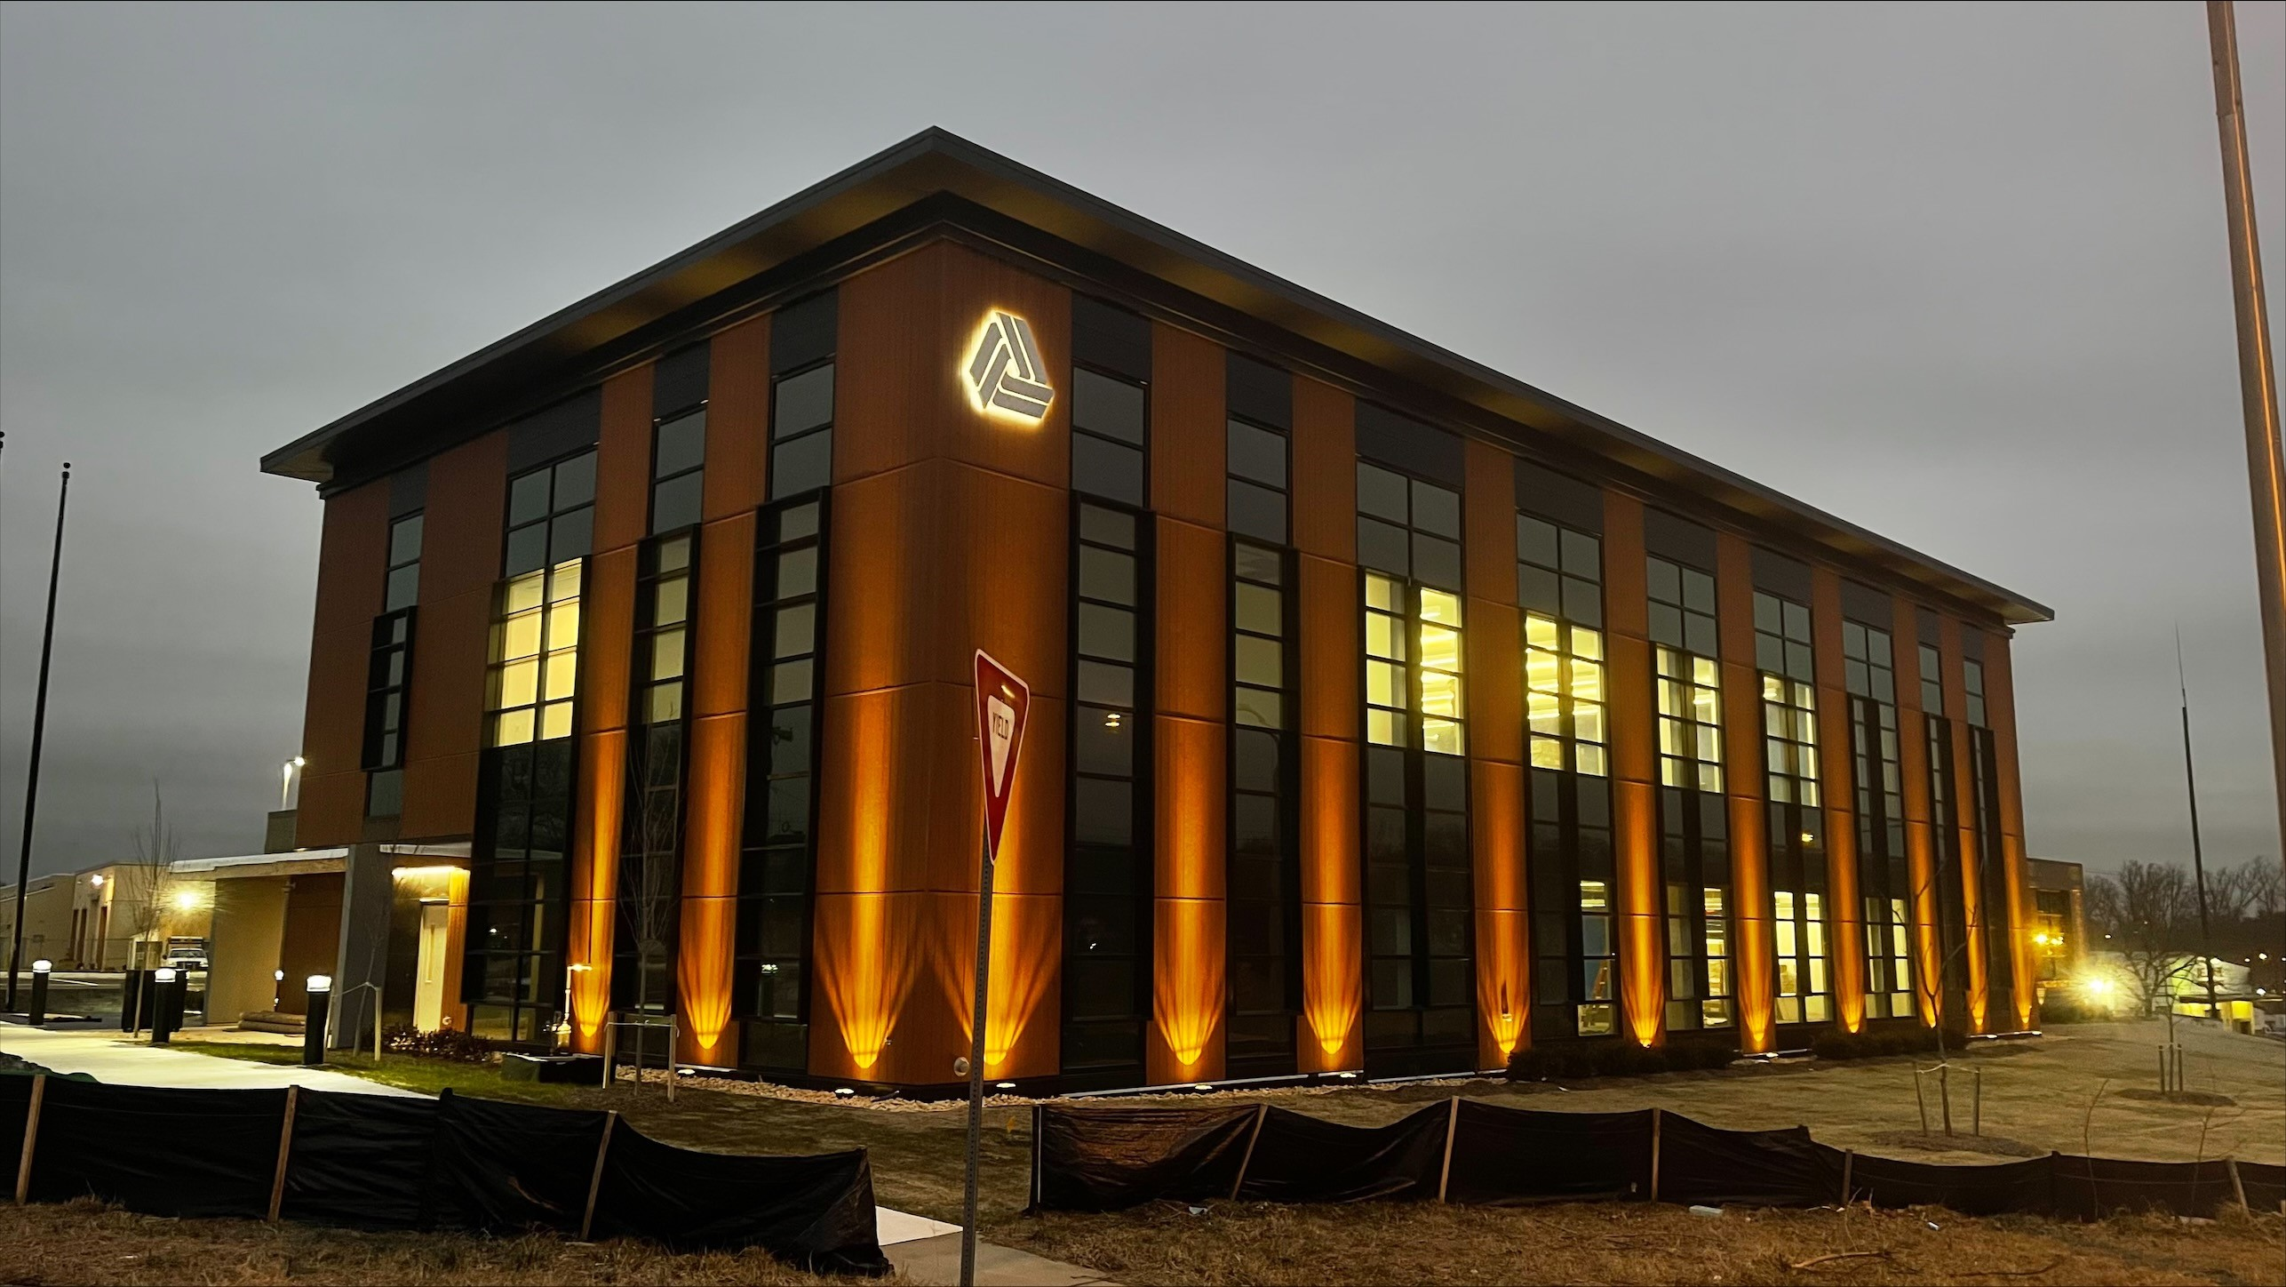
Questions?

